Slide 1

Topic: practical lesson

Slide 2
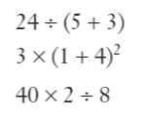
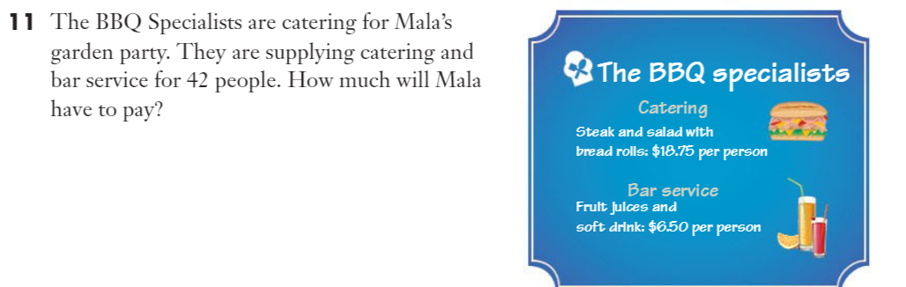
warm up…

Slide 3
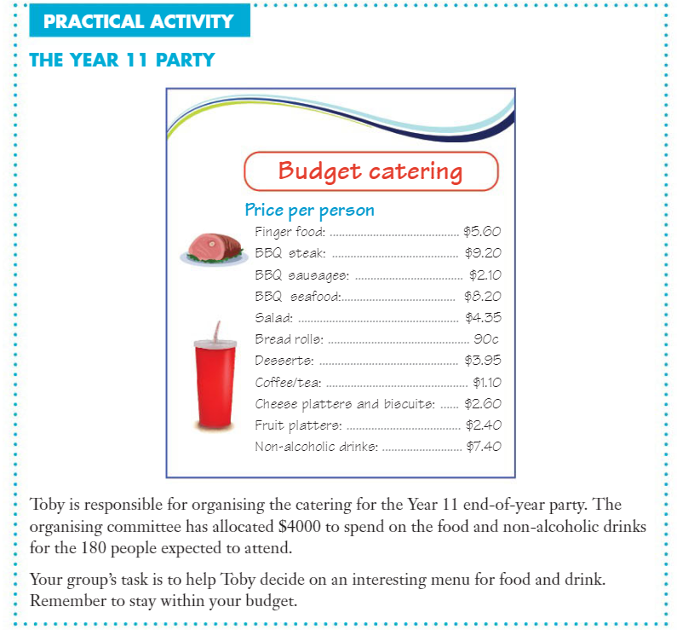

Slide 4
Interpret the task
Identify the mathematics involved
Analyse information/data (you may need to use other sources)
Apply existing mathematical knowledge and strategies
Verify the reasonableness of your answer
Communicate findings | See back page

